Slide 1
Highway Materials Lecture - 14
Designed and presented
By
Asst. Prof. Dr. Raquim Nihad Zehawi

Slide 2
Example 7
Rectify the gradation of the aggregate according to the listed specification.
1 | 2 | 3 | 4
Sieve | Specifications | Target | Passing Natural Grading
3/4" | 100 | 100 | 90
1/2" | 90 – 100 | 95 | 82
3/8" | 77 – 93 | 85 | 72
No. 4 | 44 – 74 | 59 | 40
No. 8 | 24 – 58 | 41 | 26
No. 50 | 5 – 21 | 13 | 4
No. 200 | 4 – 10 | 7 | 0.5
Solution
1- Step (1): discarding the oversize. i.e. discarding the retained on 3/4" sieve which equals 10% of the whole original stock pile.
Since the 90% is going to be 100% of the new stockpile after discarding the oversize material, then all other proportions are to be computed as follows:
$$new proportion \%=\frac{100}{90}×old proportion\%$$

Slide 3
The resulting proportions as listed in column 5 are drifted away from the target towards the course Boundaries with violation in sieves No 50 and 200.
Original Stockpile
Step (2): separating the resulting stock by the sieve No.4 (4.75 mm){ * the smallest recommended sieve to separate by is No. 8 for practicality reasons. Accordingly; two stocks are resulting, the first (A) is passing No.4 ( smaller than 4.75 mm) represents 44%, and the Other (B) is retained by No.4 (larger than 4.75 mm) represents 56%. It should be noted that the proportions of this stock are computed in light of the retained proportions
10%
90% of the original
< N0.4
>No.4
Since stock (A) is 100% passing No.4 sieve, any percentage to be used from this stock will give its own proportions without any effect of stock (B) on it. i.e. the blended stock will have lower proportions of these fine particles. This may imply the utilization of a filler material to fill the gap in the sieve No. 200 and No. 50, for no matter how big the portion of stock (A) to be used the required specification will not be met.

Slide 4
Since the target is 7% in sieve No. 200, and the available gradation is less than 1.25, then the filler is required about 6%. Taking under consideration that this percentage will be added to all proportions of the passed materials.
Depending on the sieve No.4 specification target which is 59% and in order to have it verified, in addition to the 6% of the filler plus 0% from stock (B), a 53% of stock (A) is required to complete the 59%. This may by the lead to the first iteration or trial. This trial states the blending of the following:
6% filler + 53% stock (A) + x% stock (B) = 100
X stock (B) = 100 – 6 – 53 = 41%
According to the final blended stock proportions the coarse, fine and filler proportions are computed as follows:
Coarse aggregate = 100 – Passing No.4 = 100 – 59 = 41%
Fine Aggregate = Passing No.4 – Filler = 59 – 6.7 = 52.3%
Filler = = 6.7 %
Total = 41 + 52.3 + 6.7 = 100%

Slide 5
5 | 6 | 7 | 8 | 9
Step (1) discarding 3/4" | Step (2)
 | (A ) Passing No.4 | (B) Retained No.4 | (B) Retained No.4 | (B) Passing No.4
100 | 100 | 100 – 100 = 0 | 0 | 100
(100/90)*82= 90 | 100 | 100 – 90 = 10 | (100/56)*10= 18 | 100 – 18 = 82
(100/90)*72= 79 | 100 | 100 – 79= 21 | (100/56)*21=37.5 | 100 – 37.5= 62.5
(100/90)*40= 44 | 100 | 100 – 44 = 56 | 100 | 100-100 =0
(100/90)*26= 29 | (100/44)*29=66 |  | 100 | 0
(100/90)*4= 4.4 | (100/44)*4.4=10 |  | 100 | 0
(100/90)*0.5= 0.55 | (100/44)*0.55=1.25 |  | 100 | 0
10 |  |  | 11
Step (3)
53%(A) | 41% (B) | 6% Filler
0.53X100 | 0.41X100 | 0.06X100 | 53+41+6=100
0.53X100 | 0.41X82 | 0.06X100 | 53+33.6+6=92.6
0.53X100 | 0.41X62.5 | 0.06X100 | 53+25.6+6=84.6
0.53X100 | 0.41X0 | 0.06X100 | 53+0+6= 59
0.53X66 | 0.41X0 | 0.06X100 | 35+0+6= 41
0.53X10 | 0.41X0 | 0.06X100 | 5.3+0+6= 11.3
0.53X1.25 | 0.41X0 | 0.06X100 | 0.66+0+6= 6.7

Slide 6
H.W.
Three aggregates are to be blended to meet specification. The aggregates, gradations, and specifications are as in Table below. Determine the most suitable proportion of each stock using the trial and error method.

Slide 8
DESIRABLE PROPERTIES ASPHALT MIXTURES
Stability : resistance to permanent deformation due to the
applied loading (plastic deformation).
Stability is affected by:
Rough aggregate surface texture
Optimum asphalt content
Frictional resistance
Dense gradation
Compaction
Rheology of asphalt
Cohesion (tensile strength)
Adhesion with aggregate
Surface area of aggregate

Slide 9
Speed of vehicles
Inertia of pavement
Concentration of load
Axle load
2) Durability: Resistance to weathering (air, water, & oil) &
abrasive action of traffic.
Durability is affected by:
Asphalt content (asphalt film)
Gradation (dense or open)
Degree of compaction

Slide 10
3) Flexibility: The ability to bend repeatedly without fracture.
(fatigue resistance)
4) Skid resistance: The ability to provide safe coefficient of
friction.
Asphalt content
Skid resistance is affected by:
Gradation (dense or open)
Fractured aggregate
5) Imperviousness: Lack of permeability
6) Workability: The ability to provide smooth shaping of the
finished pavement.
Balanced portions of materials
Workability is affected by:
Efficient equipment's

Slide 11
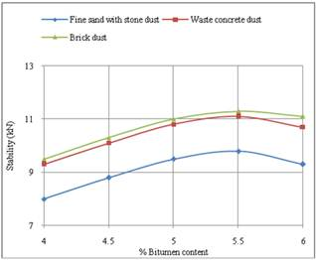
JOB MIX FORMULA
The process in which the proportions of all types of ingredient materials are decided to provide the asphalt mixture desirable properties.
1- the selection of aggregate quality
( hard, rough, hydrophobic, . . . Etc.)
Well graded to ensure ( contact surface, workable, flexible, impermeable)
2- the selection of asphalt grade
hard enough: to provide sufficient tensile strength at elevated temperature.
Soft enough: for durability, flexibility, workability.
3- the selection of optimum asphalt content
Using as much as possible: for durability, flexibility, workability.
Using not so much that stability may reduce below some minimum value.

Slide 12
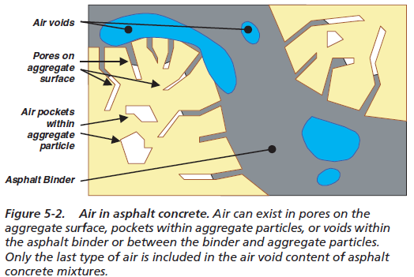
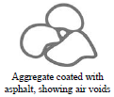
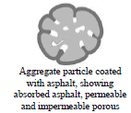
ANALYSIS OF MIXTURE

